Slide 1
Tourism’s effects on Antarctic Animals
How they respond to human induced environmental changes from tourism.
Notes:
These are the slides for Lesson three, Antarctic animals.
Teacher notes have been added at the bottom of most slides.
I would recommend going through the slides before teaching so you are aware of any animation present.
Background image was my own image, taken on Ross Island.

Slide 2
Tourism numbers
Notes:
This image show the increase in tourism over the years. This should be looked at very briefly just to show students that numbers are increasing.
The dip after 2006 was from the financial crises.
The last three years has seen a continue incease.
Taken from: Tin, T., et al. (2013). Antarctic Futures: Human Engagement with the Antarctic Environment. Dordrecht, Springer.

Slide 3
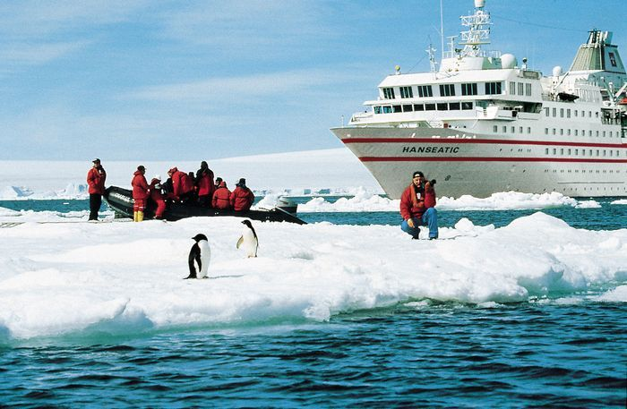
Possible tourism effects on Antarctica
Direct or indirect contact with land by foot traffic, vehicles, camp equipment, etc.
Release or loss of any garbage, sewage, oils, chemicals, noxious substances and pollutants.
From deploying and retrieving anchors and anchor chains.
Physical changes to the landscape (e.g. erosion, tracks)
Direct or indirect contact with, or approach to, wildlife
What?
How?
From vessel’s engines, generators and incinerators.
Sound and light from the operation of vessels and small boats.
Tourist infrastructures.
By vessel movement or propulsion.
Alien species introduced.
Pollution of marine and land environments.
Disturbance and damage of benthic marine species and habitats.
Disturbance to the water column and breaking of sea ice
Altered ecosystem performance
Notes:
Image taken from: en.mercopress.com
This slide is very information heavy but most of the information should be revision from previous lessons.
Read the information out to students, discuss if needed. This is just a selection of ideas on how tourism effects Antarctica.
Concepts were worded to be as self explanatory as possible.
For more information on these look at the ‘Environmental aspect’ document from lesson three.
Remind students that these issues will be increased with the rise in tourism.

Slide 4
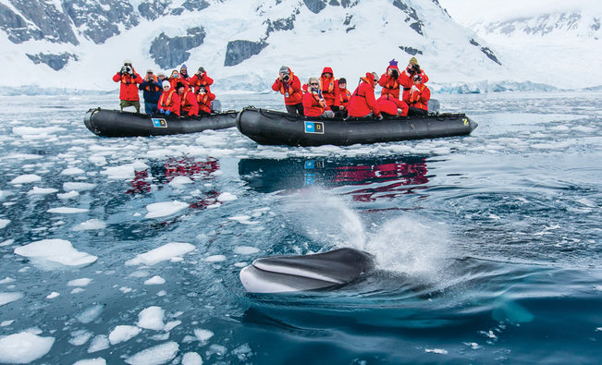
Possible tourism effects on whales
Change in food source
Effects
Illness
Death
Forced change in movement patterns
Physical disturbance
Notes:
These slides are designed as points of conversation rather than be information heavy.
While the possible environmental affects of tourism has been well hypothesized there is still little long term research on its effects tourism might have for the Antarctic wildlife.
Based on the effects from the previous slides these are some possible effects to whales:
Change in food source: With an increase of ships you have the possibility of more damage to marine environments leading to more damage to the ecosystem. This may lead to whale starvation. Alternatively with the break up of ice whales may have more accessibility allowing them to catch more pray.
Illness: Spill of waste, pollution and oil from disasters could cause the whales to get ill even leading to death.
Forced change in movement patterns: Changes to the water ways could cause the whales to use new movement patterns changing their behaviors. The increase in large vessels activities might also deter whales from visiting areas.
Physical disturbance: from interaction with the animals.
Death: well extreme this could be a result of a continued increase of the other effects. With more vessels you have a higher chance of whales being struck by vessels leading to injuries of death.
http://www.nationalgeographicexpeditions.com/assets/images/3029/itinerary-header.jpg

Slide 5
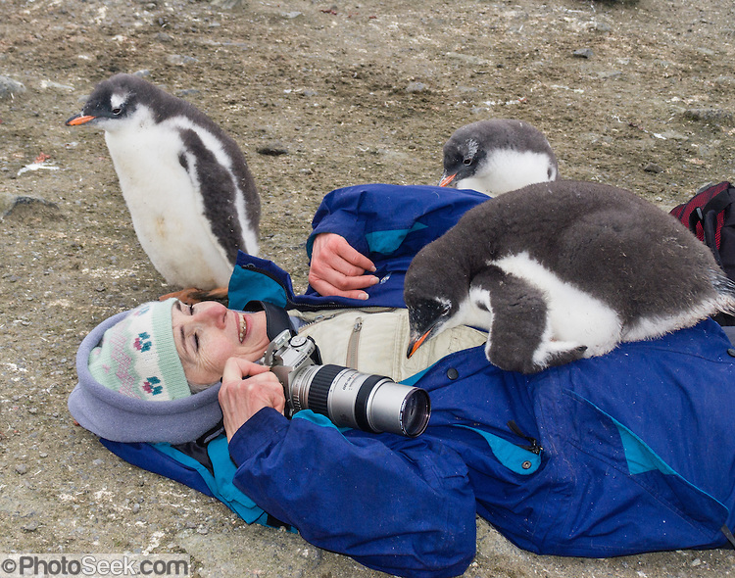
Possible tourism effects on penguins
Change in food source
Physical disturbance
Effects
Illness
Death
Change of behaviour, physiology and breeding success.
Forced change in movement patterns
Notes:
Change in food source: With an increase of ships you have the possibility of more damage to marine environments leading to more damage to the ecosystem. Noise and disturbance around popular tourist destinations (as most ships go to penguin colonies), could cause migration of penguins food sources, causing starvation or forced penguin migration.
Illness: Spill of waste, pollution and oil from disasters could cause the penguins to get ill even leading to death, or waste left by tourists.
Forced change in movement patterns: Changes to the penguin tracks, from ground disturbance.
Physical disturbance: from interaction with the animals, creating fear or change of routines. This could (and some say has) caused decrease in breeding.
More information at:
http://quest.arc.nasa.gov/antarctica/background/NSF/penguins.html
http://www.sciencedirect.com/science/article/pii/S0006320703004543
http://archive.news.softpedia.com/news/Penguins-Are-Threatened-By-Human-Activity-40529.shtml
Death: well extreme this could be a result of a continued increase of the other effects.
Photo from: photoseek.photoshelter.com

Slide 6
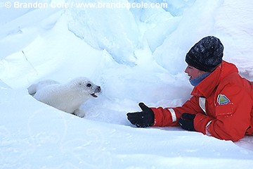
Possible tourism effects on seals
Change in food source
Physical disturbance
Effects
Death
Illness
Change of behaviour, physiology and breeding success.
Forced change in movement patterns
Notes:
Seals could suffer similar affects as penguins.
Picture from: www.brandoncole.com

Slide 7
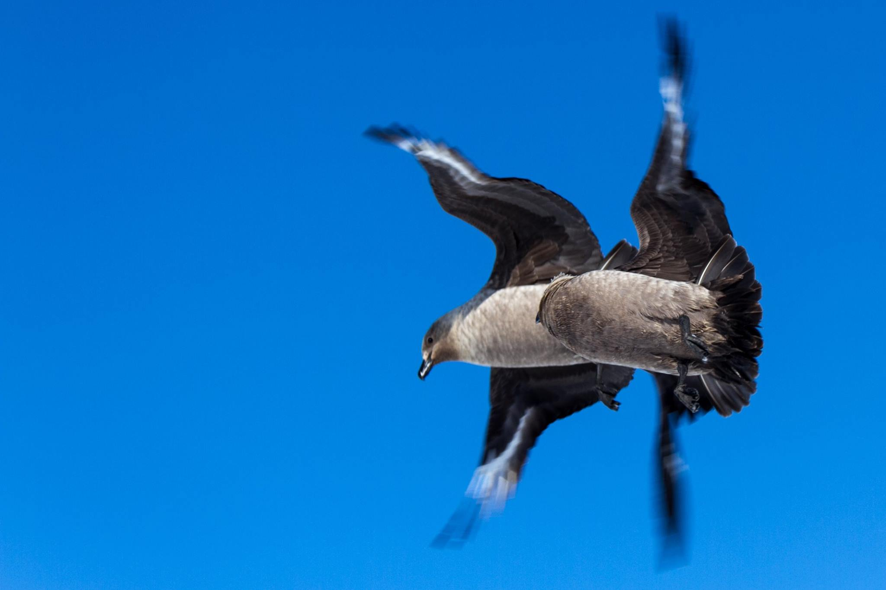
Possible tourism effects on birds
Change in food source
Physical disturbance
Effects
Death
Illness
Change of behaviour, physiology and breeding success.
Forced change in movement patterns
Notes:
Change in food source: These birds often scavenge their food. With more tourists there is a greater possibility in these birds scavenging from unsuspecting tourists.
Discharge / escape of light from windows and other sources during dark hours can result in injury or death of seabirds striking vessels.
Pictures taken from classmate: James Stone

