Slide 1
Antarctic Animals
Notes:
These are the slides for Lesson two, Antarctic animals.
Teacher notes have been added at the bottom of most slides.
I would recommend going through the slides before teaching so you are aware of any animation present.
Background image was my own image, taken on Ross Island.

Slide 2
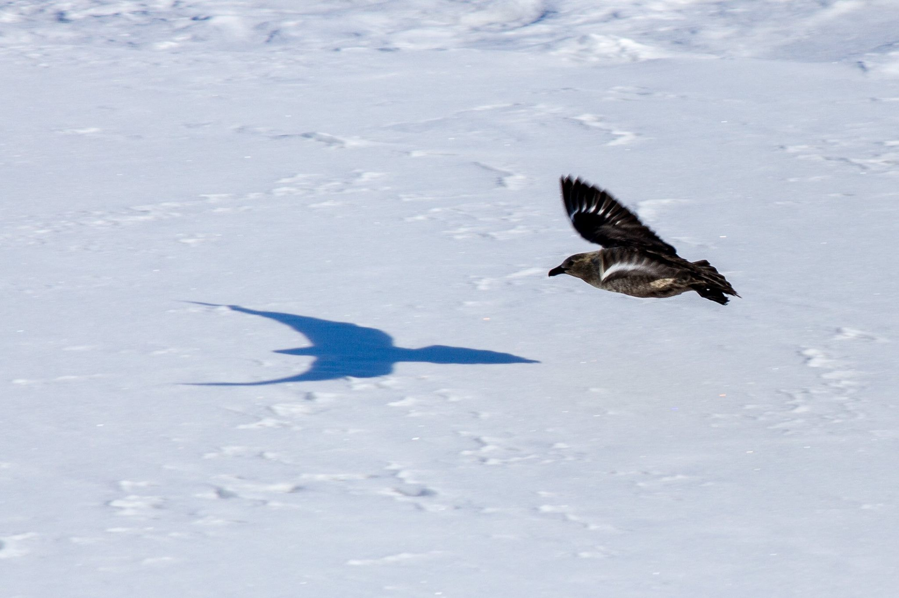
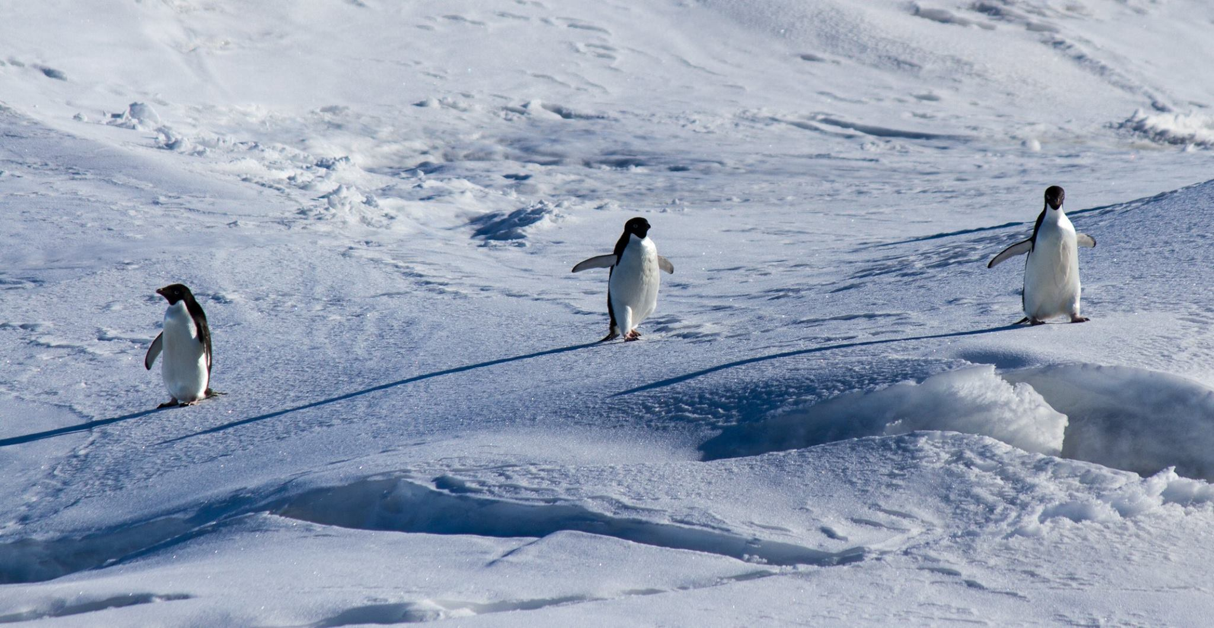
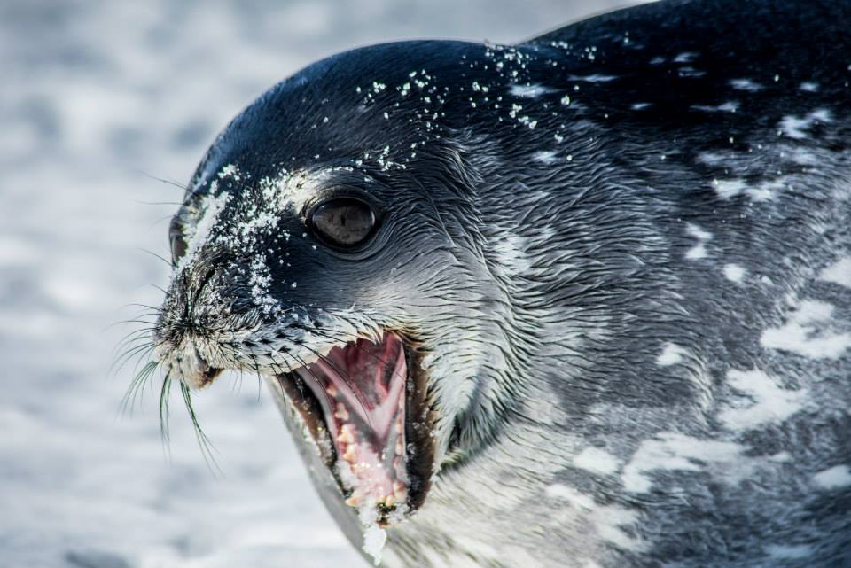
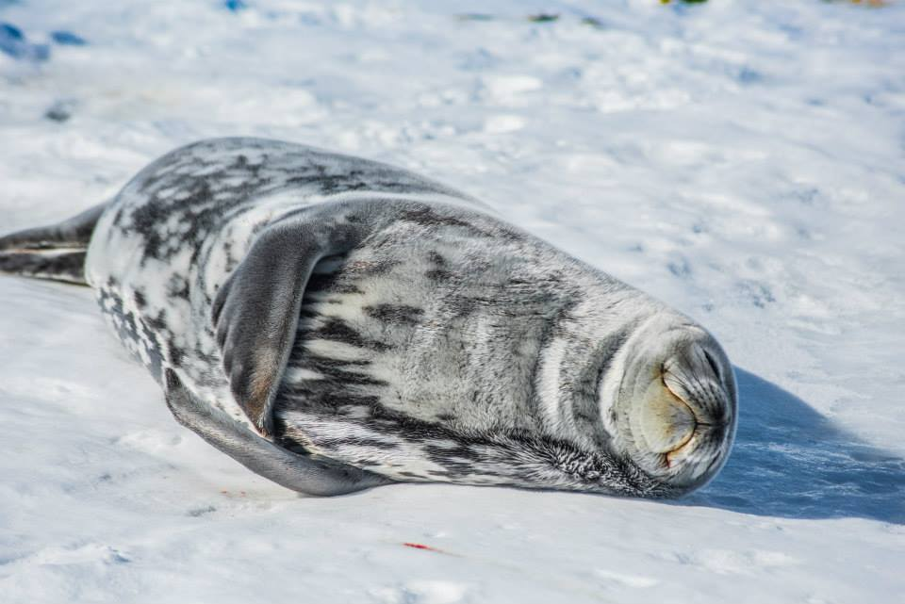
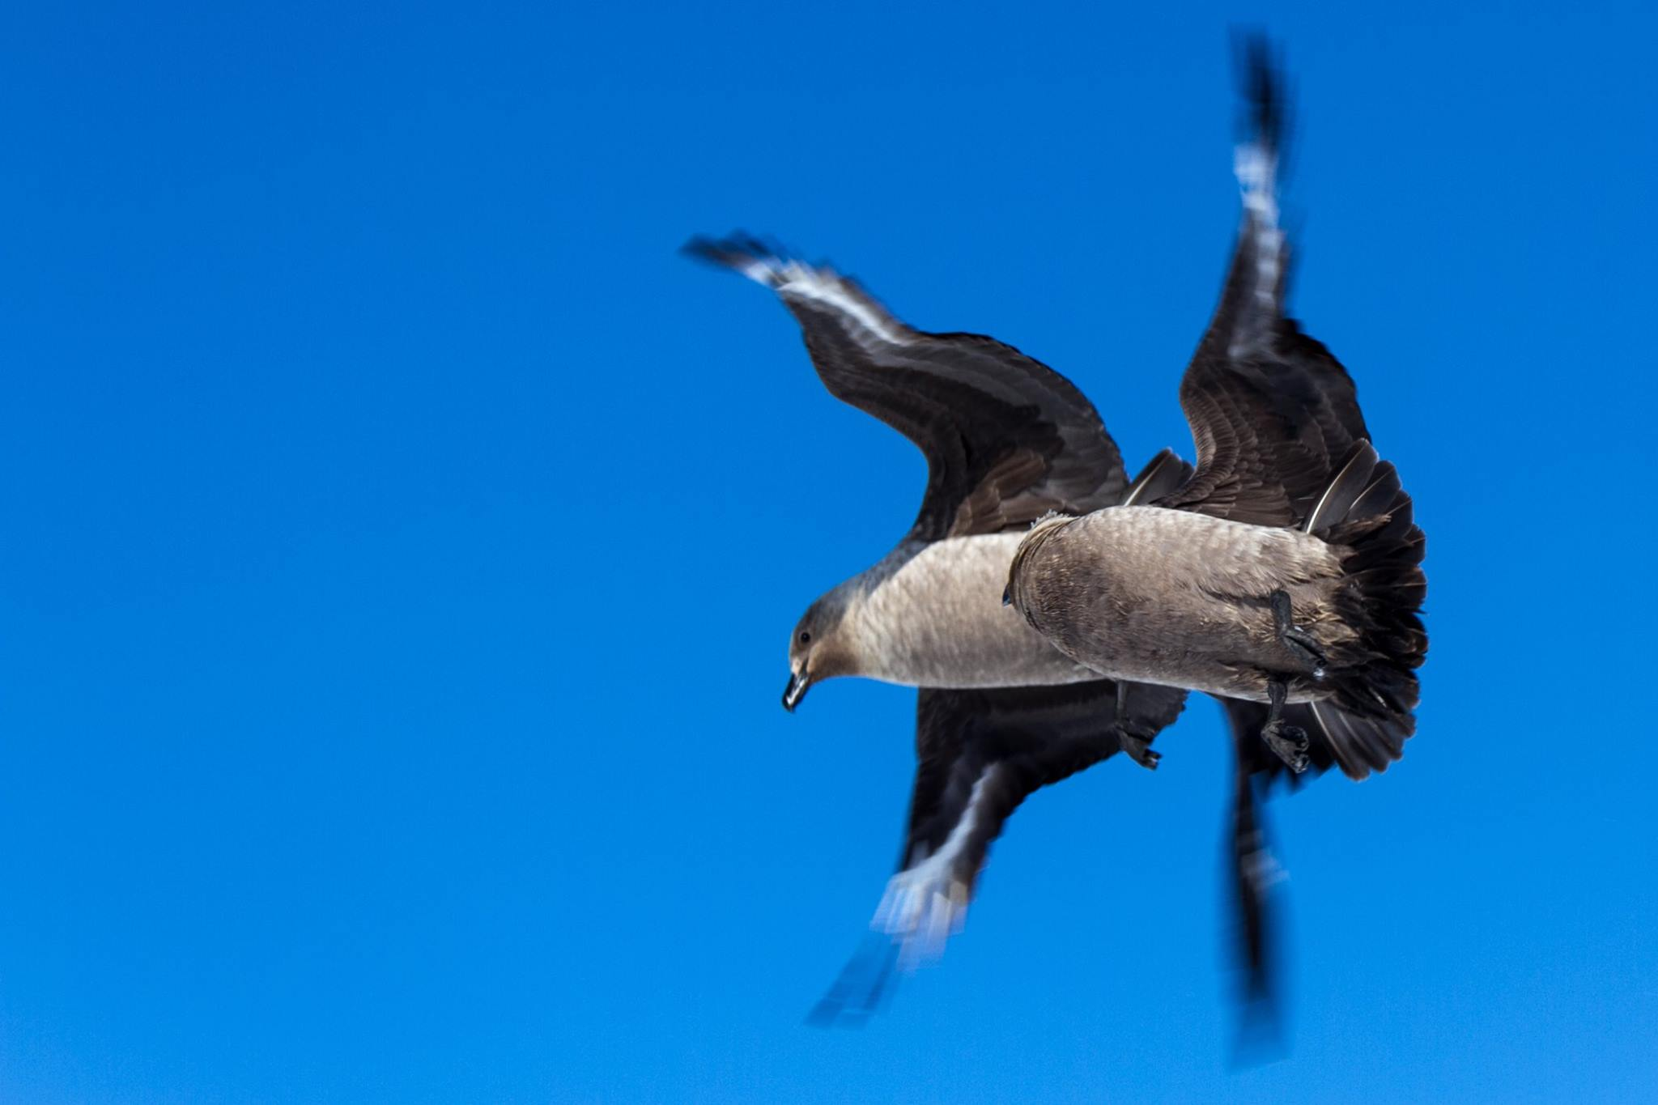
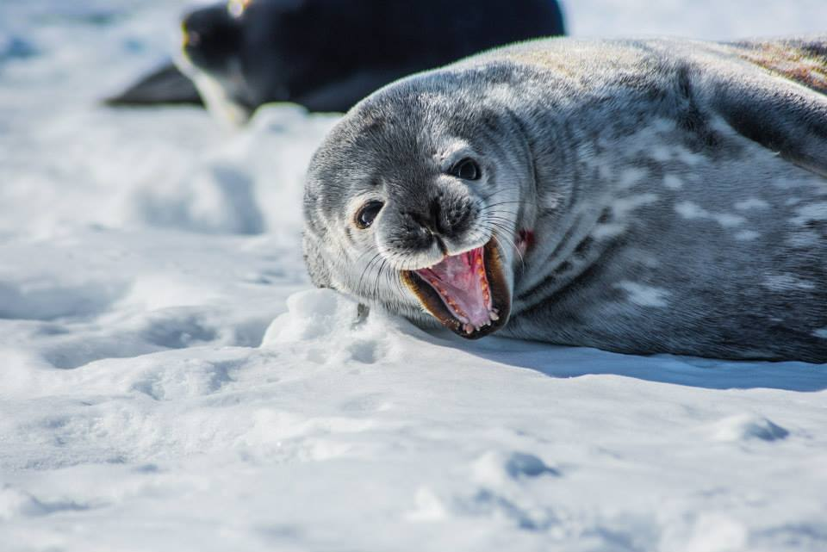
Notes:
These are some pictures classmates and I took on our trip down south. It is designed to gain the students curiosity and interest.

Slide 3
What characteristics do animals need to survive in the Antarctic?
Quick activity: draw a diagram like the one to the left.
Identify all the features an animal might need if living in Antarctica, like ‘ability to keep warm’.
Notes:
This section allows teachers to asses the students prior knowledge while using information from the previous lessons. This should be very brief with only a few points listed. Prompt students to think about the habitat that they live in, and what they will need to overcome it.
Have students have a quick peer share session before discussing as a class.
Extension: Circle the one feature you believe is most important and explain why.
Characteristics could include: Ability to keep warm, ability to swim (most food being in the water), ability to camouflage with the snow/ice, ability to get on land, not to slip ect

Slide 4
How are penguins suited for Antarctica?
King Penguins have four layers of feathers to help keep them warm.
Emperor Penguins can stay underwater for around 20 minutes at a time.
They have dense double layer of feathers and a large fat reserve.
They also huddling together for warmth to prevent heat loss.
While other birds have wings for flying, penguins have flippers to help them swim in the water.
Penguins can drink sea water.
Penguin’s black and white plumage serves as camouflage while swimming.
Notes:
Begin by showing this image to students. Ask the students if they can answer this question first.
After a short discussion click to bring up the text boxes. Read the text out to students.
Picture is taken myself down in Antarctica

Slide 5
How are seals suited for Antarctica?
Weddell seals are very vocal. Their calls can be heard from atop the ice even when seals themselves are below.
They have a very thick layer of blubber between their skin and their vital organs to help keep them warm at sea
Weddell seals use their teeth to open and maintain air holes in the ice pack.
They can dive deeply and go for extended periods of time without eating
They are also known for their aggression and for eating Penguins.
Notes:
Begin by showing this image to students. Ask the students if they can answer this question first.
After a short discussion click to bring up the text boxes. Read the text out to students.
Picture is taken myself down in Antarctica

Slide 6
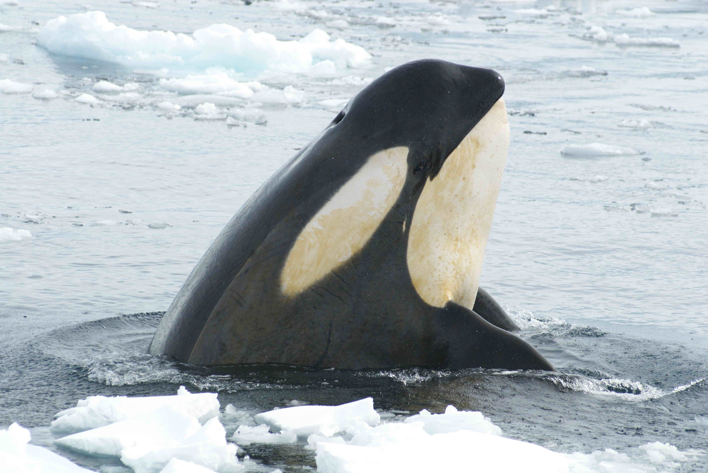
How are whales suited for Antarctica?
They are also able to kill large prey and are known for their intelligence.
They have a thick layer of blubber to keep them warm.
Antarctic Blue Whales spend the bulk of their time-consuming massive amounts of food during feeding season.
Their mouths are filled with coarse bristles for feeding.
Blue whales have a lifespan of 70 – 90 plus years also makes them one of the oldest living species on the planet.
Orcas have a short dive time of less than thirty minutes they spend as much time near the surface as they do under water.
Rows of sharp teeth allow Orcas to be the apex predator in the Antarctic, thus earning the name “killer” whales.
Orcas hunt in groups known as “pods,” where they regularly communicate by sound
Notes:
Begin by showing this image to students. Ask the students if they can answer this question first.
After a short discussion click to bring up the text boxes. Read the text out to students.
Picture is taken from: swfsc.noaa.gov

Slide 7
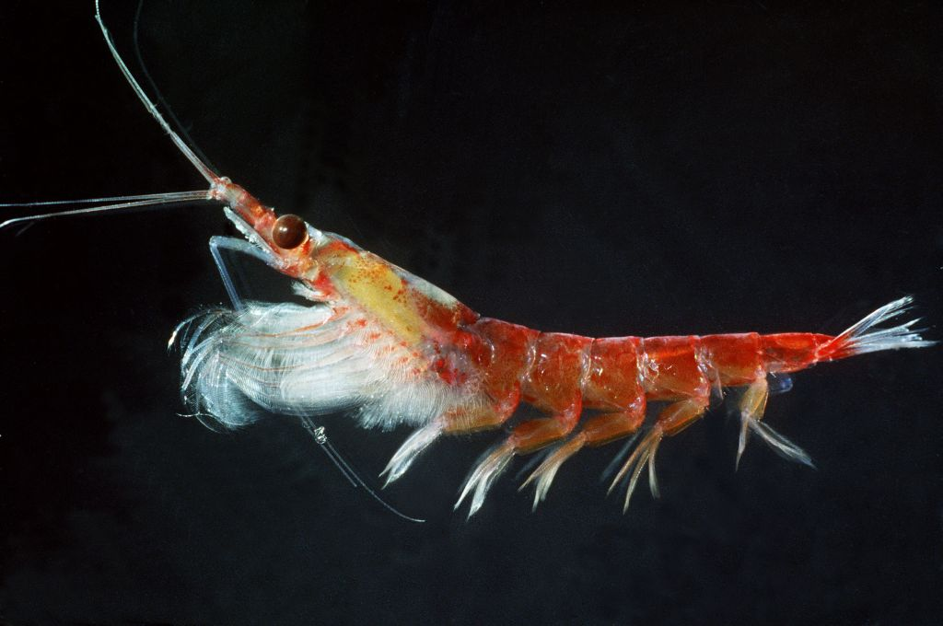
How are krill suited for Antarctica?
Krill have a hard exoskeleton, many legs which they use to swim and eat, and a segmented body.
They can withstand long periods of starvation (up to 200 days) by using their muscle as a reserve
Euphausia superba krill are the most common krill, found mostly in the waters of the Antarctic.
In the winter and spring they are found beneath the sea ice where they feed on algae.
Antarctic Krill are mainly herbivorous (they sometimes eat each other)
Notes:
Begin by showing this image to students. Ask the students if they can answer this question first.
After a short discussion click to bring up the text boxes. Read the text out to students.
Picture is taken from: http://www.antarctica.gov.au/__data/assets/image/0010/29098/varieties/antarctic.jpg

Slide 8
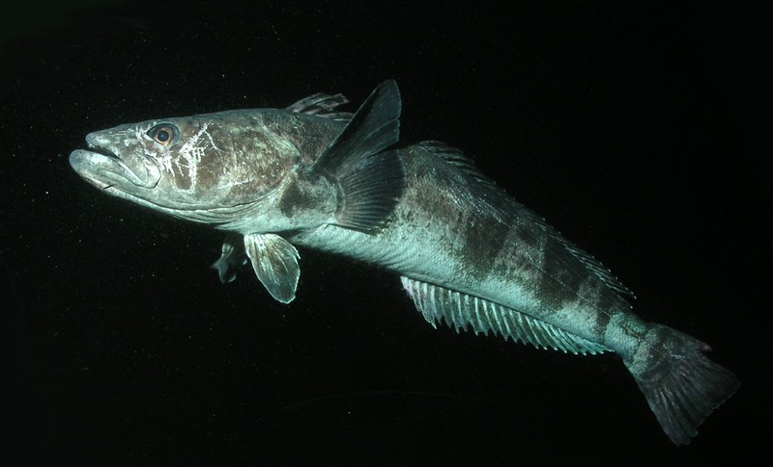
How are fish suited for Antarctica?
They have a very simple structure with antifreeze in their bodies. This prevents them from freezing during the Antarctic winters.
The mackerel icefish (Champsocephalus gunnari) urvive live without the red oxygen carrying pigment in their blood cells. This means their blood is colourless.
Notes:
Begin by showing this image to students. Ask the students if they can answer this question first.
After a short discussion click to bring up the text boxes. Read the text out to students.
Picture is taken from: www.lastocean.org

