Slide 1
PowerPoint for: Antarctic habitats
Notes:
These are the slides for Lesson one, Antarctic Habitats.
Teacher notes have been added at the bottom of most slides.
I would recommend going through the slides before teaching so you are aware of any animation present.
Background image was my own image, taken on Ross Island.

Slide 2
Video:
Notes:
This is the imbedded link for the video of Antarctic scenery. Students should think of new words to describe the continent while watching the video.

Slide 3
Habitat Definition:
“The natural environment of an organism”
“Place that is natural for the life and growth of an organism”
http://dictionary.reference.com/
Notes:
Before giving these definitions have the students discuss their own definition/understanding of the word. The definitions will pop up invidually with mouse clicks.
First click pops up first definition.
Second click pops out second definition.
Keep the topic purely about the definition, try not to discuss the Antarctic context yet, as that will come later.

Slide 4
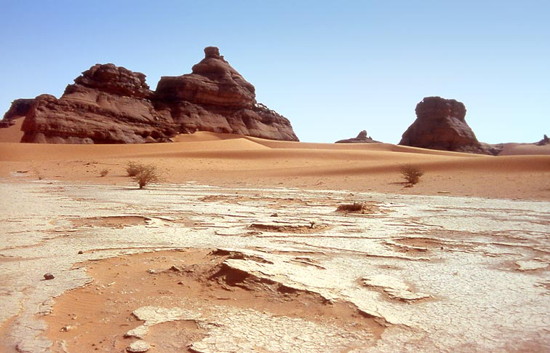
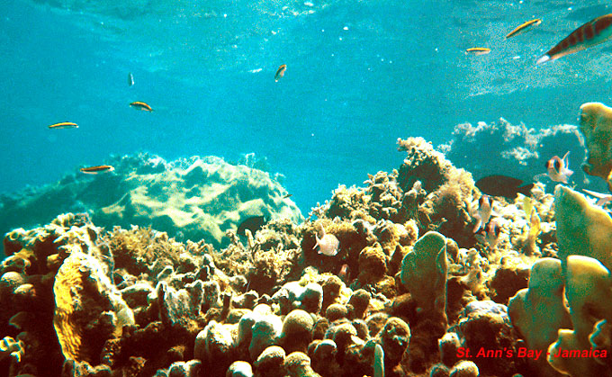
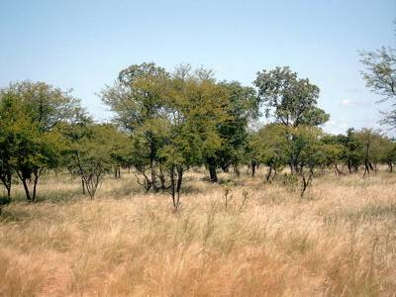
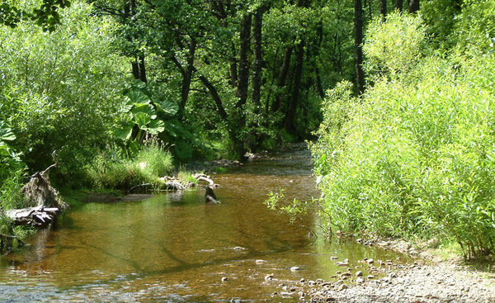
Notes:
These images are designed to assist students with their understanding of the concept of habitats.
Tell students that these are some examples of habitats, ask I students recognize any areas like this?
Describe the pictures to the students, getting them to go beyond calling it a dessert (e.g. dry, sandy, flat, brown ect)
For more advanced students begin talking about the organisms that live there.
No animation on this slide.
Images are from:
http://pegasus-express.deviantart.com/art/World-longest-Panorama-39320311
http://www.spiritandsong.com/articles/13762
http://www.speyfisheryboard.com/bailiffs/
www.macroevolution.net
www.awf-volunteeringabroad.org

Slide 5
Antarctica's Habitats
Ice
Mountains
Islands
Seas
Notes:
This slide should be brief. If desired you could introduce the topic by asking students what type of terrain they might find in Antarctica? Otherwise simply read the slide out to students.
“There are at least four different types of habitats in Antarctica…”
Click one: Will bring up the 4 bullet points straight after each other.

Slide 6
Ice sheet & Sea Ice
Openings
Plant free
Cold
Bright
Cracks
Flat
Empty
Clean
Wet
Big
Ice
Sea
Land free
Slippery
Antarctica’s sheet ice is thick ice that stays there year round. The Sea ice usually forms over the winter months when the seas surrounding Antarctica freeze. Over the summer period the ice cracks and forms these huge floating pieces of ice, known as Pack Ice.
Notes:
Ice sheet & Sea Ice:
I would begin this slide by reading the text bellow the image out to the class.
Have students discuss with a peers or with the class describing the picture. You may need to get the students started by stating obvious answers, such as cold and ice. This will come in use for latter lessons where students need to know why animals are suited for their environments.
The mouse click will bring up some example words to describe the area.
Ask students if there are any new one they didn’t think up there, or if they had ones that are not up there.
Additional info: Ice sheets are generally thicker than the Sea Ice. The Antarctic Ice Sheet covers about 98% of the Antarctic continent and is the largest single mass of ice on Earth. It covers an area of almost 14 million square km (5.4 million sq. miles) and contains 26.5 million cubic km of ice. Approximately 61 percent of all fresh water on the Earth is held in the Antarctic ice sheet.
Sea ice extends far north in winter and retreats almost to the coastline each summer. Sea ice freezes from seawater, and is usually less than a few meters thick. There are two subdivisions of sea ice: fast ice, which is attached to land; and ice floes, which are not. It is often snow-covered, and generally melts from below.
“Around the coasts of Antarctica, temperatures are generally close to freezing in the summer (December–February) months, or even slightly positive in the northern part of the Antarctic Peninsula. During winter, monthly mean temperatures at coastal stations are between −10°C and −30°C but temperatures may briefly rise towards freezing when winter storms bring warm air towards the Antarctic coast.” http://www.antarctica.ac.uk/about_antarctica/geography/weather/temperatures.php
Picture was taken myself, out of the window flying down south.
Click one: Brings up describing words one after another.

Slide 7
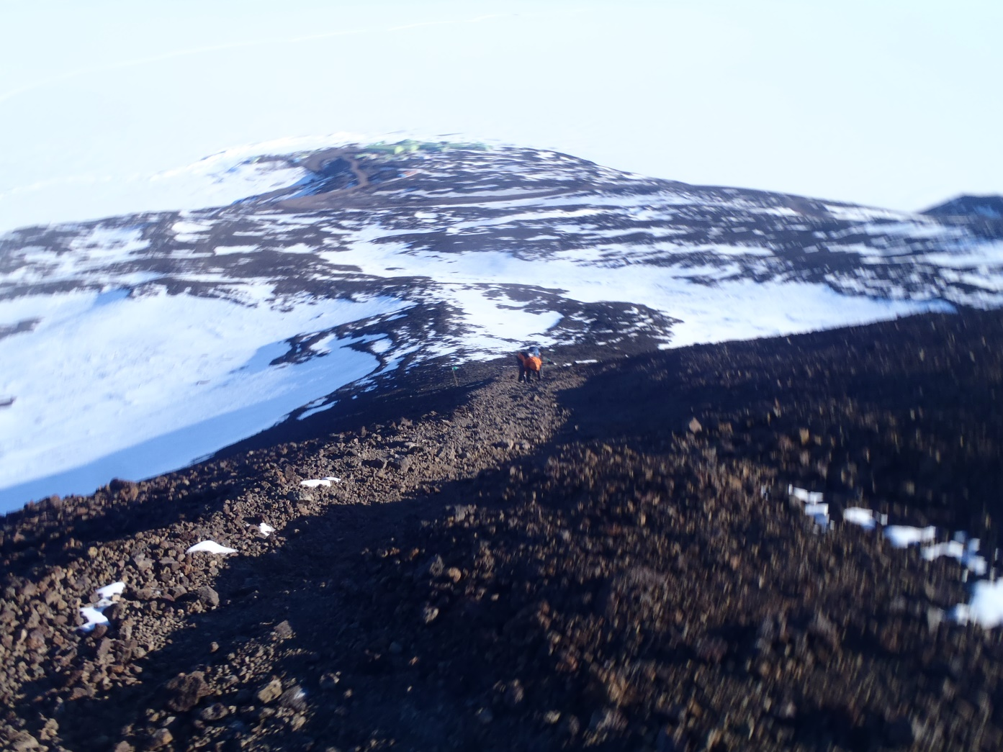
Mountains and rocky areas
Dry
Steep
Cold
Ice
Empty
High
Snow
Rocky
Most of the mountains in Antarctica are entirely covered by think ice sheet. Only the highest escape the ice sheet to reveal these rocky areas.
Notes:
Mountains and rocky areas:
I would again begin this slide by reading the text bellow the image out to the class.
Again have students discuss with a peers or with the class describing the picture. Students should need less guidance this time around, having got the concept in the earlier slide.
The mouse click will bring up some example words to describe the area.
Ask students if there are any new one they didn’t think up there, or if they had ones that are not up there.
Additional information: There are many mountains around Antarctica. Vinson Massif is the highest mountain in Antarctica at 16,050 ft / 4,892 m and one of the Seven Summits. It is located about 750 miles from the South Pole. The second highest is Mount Tyree at 15,919 ft / 4,852 m. Mount Erebus on Ross Island (where NZ’s Scott Base is located) is the second highest volcano in Antarctica at an elevation of 3,794 m (12,448 ft), the highest is Mount Sidley.
For a map with mountains check out the following link: http://peakery.com/explore/map/?country=AQ
The total ice-free area of Antarctica comprises less than 0.4% of the continent. The ice-free regions, of which about 90% are soil forming, are located mainly on the continental coastline, particularly on the Antarctic Peninsula and in the McMurdo Dry Valleys in the Ross Sea Region.
“Conditions on the high interior plateau are much colder as a result of its higher elevation, higher latitude and greater distance from the ocean. Here, summer temperatures struggle to get above −20°C and monthly means fall below −60°C in winter. Vostok station holds the record for the lowest ever temperature recorded at the surface of the Earth (−89.2°C) “ http://www.antarctica.ac.uk/about_antarctica/geography/weather/temperatures.php
Picture was taken myself, behind Scott Base looking down.
Click one: Brings up describing words one after another.

Slide 8
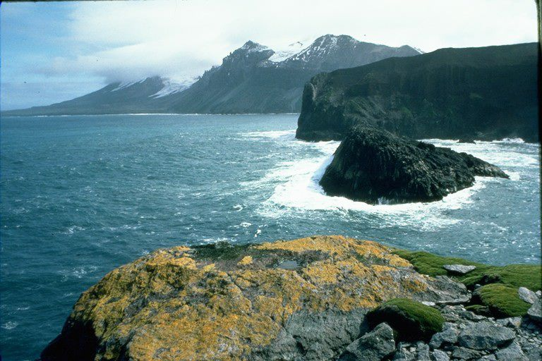
Sub-Antarctic Islands
Plants
Ice-free
snow
Sea
Rocks
Mountains
Waves
In the sub-Antarctic region there are lots of small islands. Some of these islands are almost completely capped by glaciers while others are ice free.
Notes:
Sub-Antarctic Islands:
Begin this slide by reading the text bellow the image out to the class.
Again have students discuss with a peers or with the class describing the picture. Students should need less guidance this time around, having got the concept in the earlier slide.
The mouse click will bring up some example words to describe the area.
Ask students if there are any new one they didn’t think up there, or if they had ones that are not up there.
Additional information: Antarctic islands are the islands around Antarctica situated south of the Antarctic Convergence. Sub Antarctic islands are the islands around Antarctica situated north of and adjacent to the Antarctic Convergence.
According to the terms of the Antarctic Treaty, claims to sovereignty over lands south of 60°S are not asserted. This includes some of the Antarctic islands and none of the sub Antarctic ones.
The New Zealand Subantarctic Islands comprise the five southernmost groups of the New Zealand outlying islands. They are collectively designated as a UNESCO World Heritage Site. The islands are Antipodes Islands, Auckland Islands, Bounty Islands, Campbell Island group and The Snares.
The picture was taken at Heard Island
Picture was taken from the Heritage Expedition website, http://heritage-expeditions.com/trip/south-indian-ocean/#!prettyPhoto
Click one: Brings up describing words one after another.

Slide 9
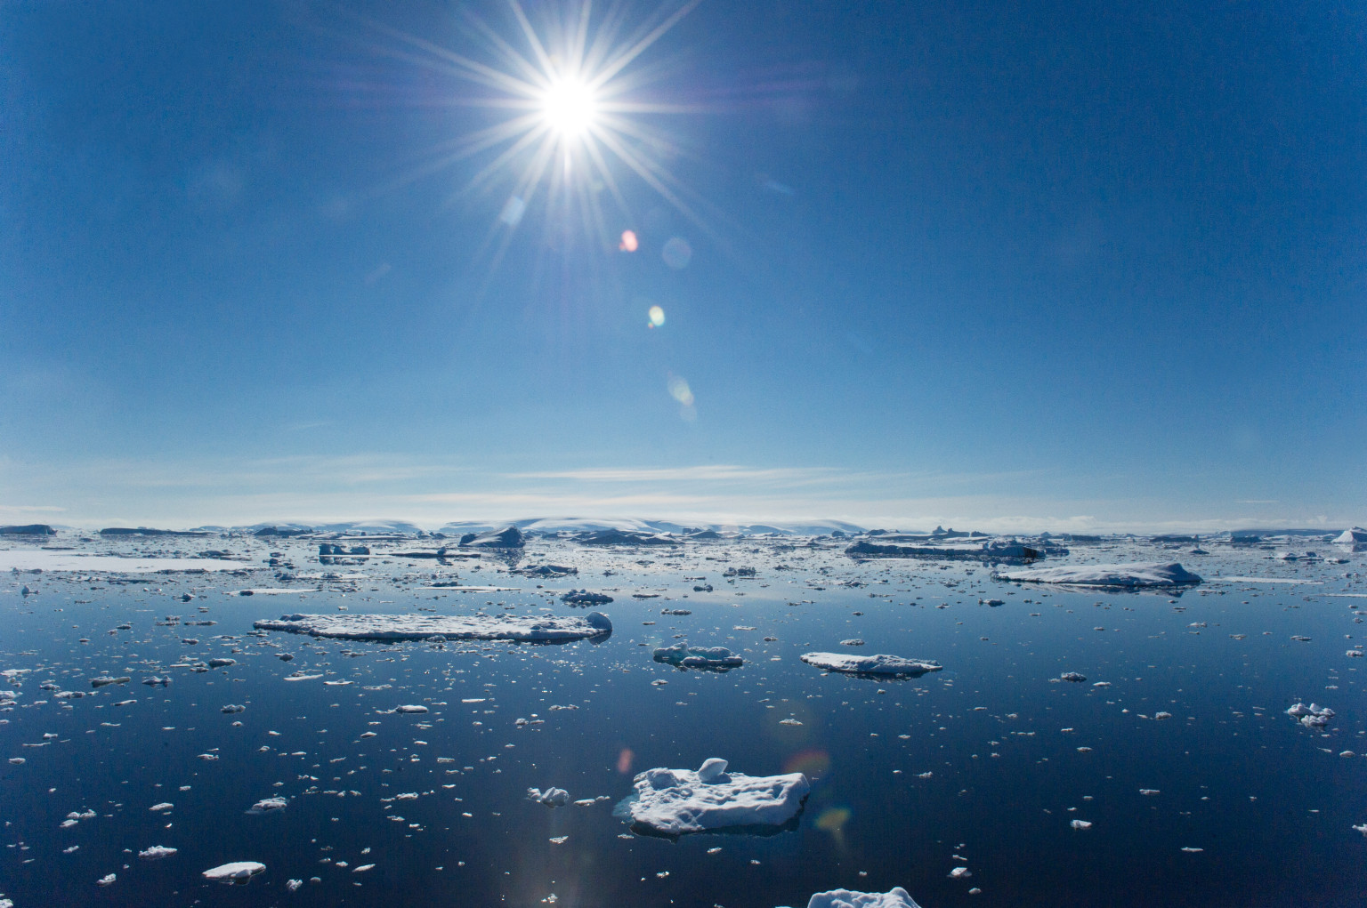
Antarctic Sea
Cold
Ice
Wet
Empty
Antarctica is surrounded by the Southern ocean. Antarctica has several recognized seas, King Haakon VII sea, Weddell Sea, Bellingshausen Sea, Amundsen Sea and Ross Sea.
Notes:
Antarctic Sea:
Begin this slide by reading the text bellow the image out to the class.
Again have students discuss with a peers or with the class describing the picture. Students should need less guidance this time around, having got the concept in the earlier slide.
The mouse click will bring up some example words to describe the area.
Ask students if there are any new one they didn’t think up there, or if they had ones that are not up there.
Additional information: Southern Ocean temperatures vary from about −2 to 10 °C. Cyclonic storms travel eastward around the continent and frequently become intense because of the temperature contrast between ice and open ocean. The ocean-area from about latitude 40 south to the Antarctic Circle has the strongest average winds found anywhere on Earth.
Picture was taken from Huffpost, http://i.huffpost.com/gen/1246068/thumbs/o-ANTARCTIC-SEA-facebook.jpg
Click one: Brings up describing words one after another.

