Slide 1
Antarctic Habitats Revision
Notes:
These are the slides for Lesson two, Antarctic animals.
Teacher notes have been added at the bottom of most slides.
I would recommend going through the slides before teaching so you are aware of any animation present.
Background image was my own image, taken on Ross Island.

Slide 2
Habitat Definition:
“The natural environment of an organism”
“Place that is natural for the life and growth of an organism”
http://dictionary.reference.com/
Notes:
Before giving these definitions have the students discuss their with each other what they remember the definitions being.
First click pops up first definition.
Second click pops out second definition.

Slide 3
Notes:
I created this using a program on www.wordle.net/
Some of the words for this will be too advanced for students. It just serves as an aid for visual learns. Either pass this quickly or get students to examine the words. More abled students could come back to this and research words that they are unfamiliar with.
http://en.wikipedia.org/wiki/Habitat is a good start for finding out about unfamiliar words.

Slide 4
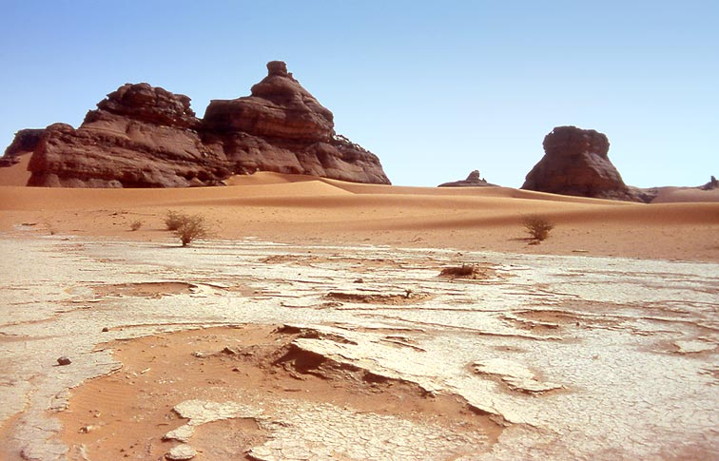
Where?
What?
Why?
Who?
Notes:
For sides 4-7 I have used the same pictures from the last habitat PPT to aid with their recall.
I have added questions for the students to discuss about the pictures (they will pop up with mouse clicks). The questions to discuss are; What (what is in the picture, describing it), where (where in the world might the picture be?), Why (why might it be like it is, e.g. for desert would be intense heat with little rain), and who (who might live there, what organisms)
To keep the session brief I would recommend having it as a class discussion rather than peers.
Have this same style of revision for slides 5, 6 and 7.
Images from slides 4-7 come from these websites:
http://pegasus-express.deviantart.com/art/World-longest-Panorama-39320311
http://www.spiritandsong.com/articles/13762
http://www.speyfisheryboard.com/bailiffs/
www.macroevolution.net
www.awf-volunteeringabroad.org

Slide 5
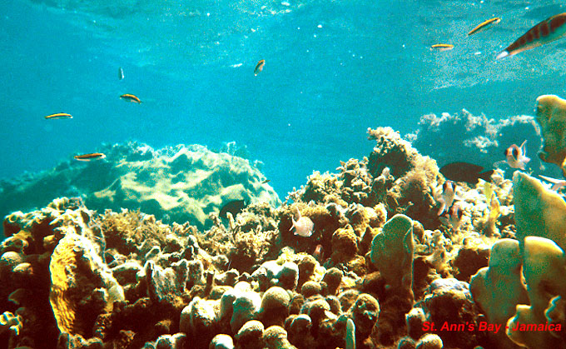
Where?
What?
Why?
Who?
Notes:
Images from slides 4-7 come from these websites:
http://pegasus-express.deviantart.com/art/World-longest-Panorama-39320311
http://www.spiritandsong.com/articles/13762
http://www.speyfisheryboard.com/bailiffs/
www.macroevolution.net
www.awf-volunteeringabroad.org

Slide 6
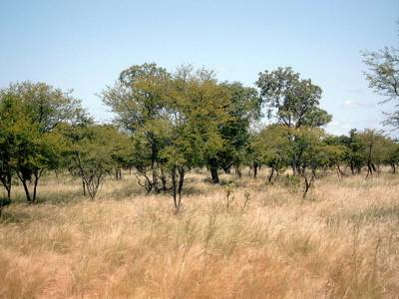
Where?
What?
Why?
Who?
Notes:
Images from slides 4-7 come from these websites:
http://pegasus-express.deviantart.com/art/World-longest-Panorama-39320311
http://www.spiritandsong.com/articles/13762
http://www.speyfisheryboard.com/bailiffs/
www.macroevolution.net
www.awf-volunteeringabroad.org

Slide 7
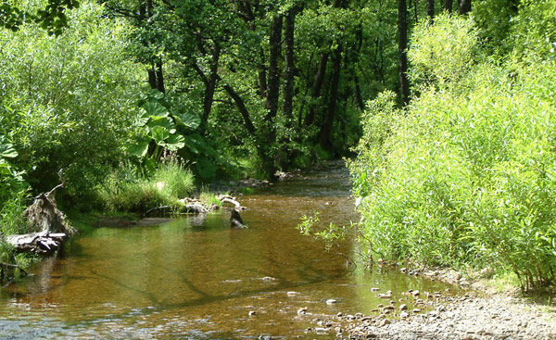
Where?
What?
Why?
Who?
Notes:
Images from slides 4-7 come from these websites:
http://pegasus-express.deviantart.com/art/World-longest-Panorama-39320311
http://www.spiritandsong.com/articles/13762
http://www.speyfisheryboard.com/bailiffs/
www.macroevolution.net
www.awf-volunteeringabroad.org

Slide 8
What were Antarctica's Habitats?
Ice
Mountains
Islands
Seas
Notes:
See if students remember what the for sections were before revealing the answers.

Slide 9
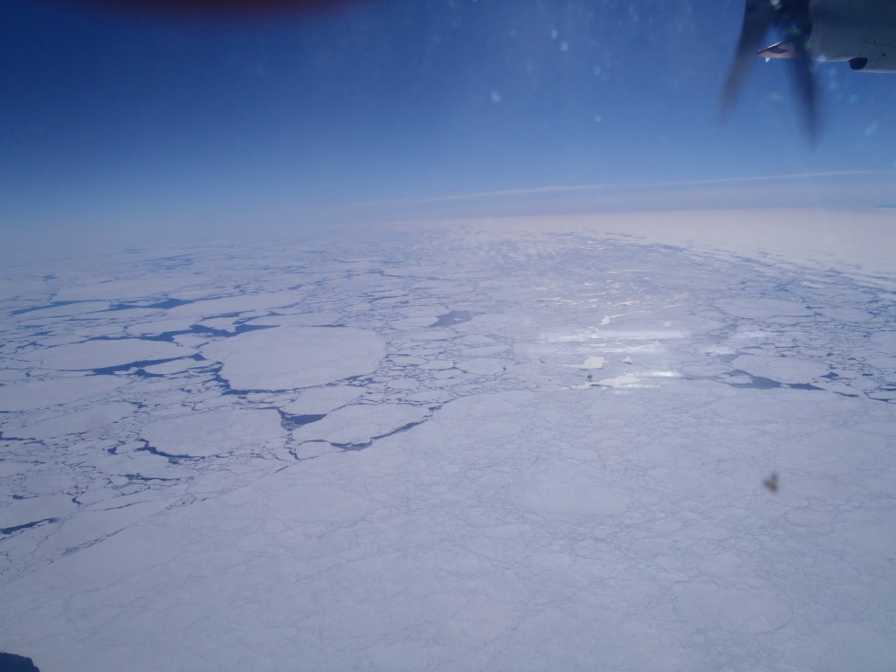
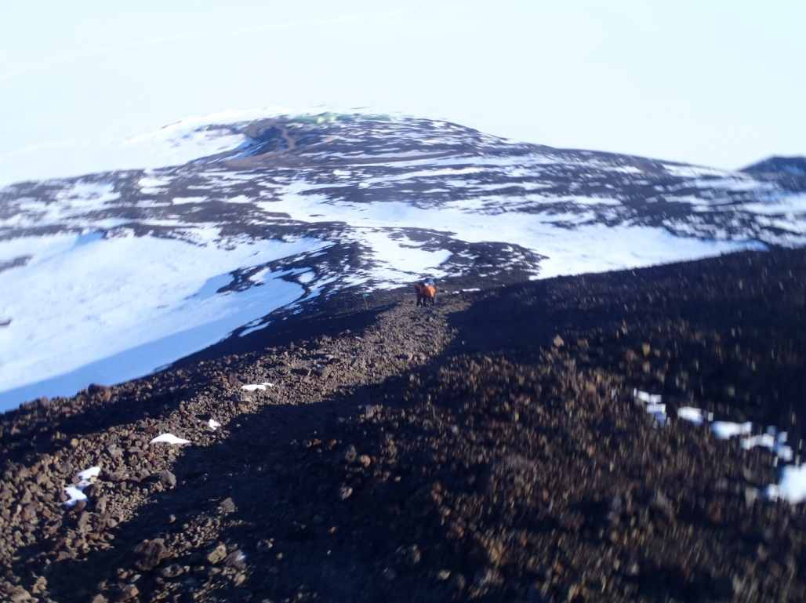
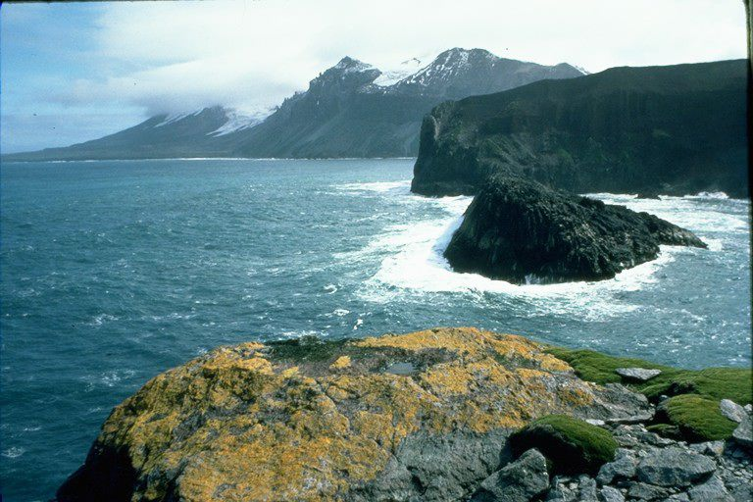
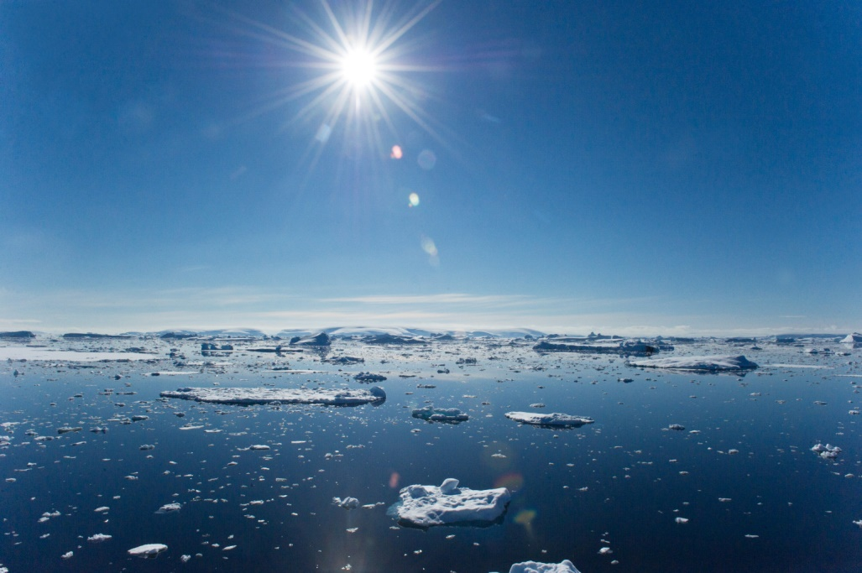
Notes:
Ask students if they can remember what Antarctic habitats these pictures belong to. Have a peer discussion about them.
http://i.huffpost.com/gen/1246068/thumbs/o-ANTARCTIC-SEA-facebook.jpg
http://heritage-expeditions.com/trip/south-indian-ocean/#!prettyPhoto

